Slide 1

Peatland restoration on
Dartmoor
David Leach
SWPP Peatland Restoration Project Officer
What is peat and why is it important?
Peatland restoration
Volunteering

Slide 2
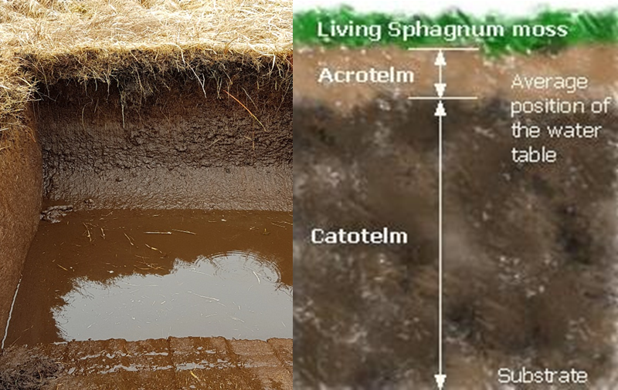

Slide 3
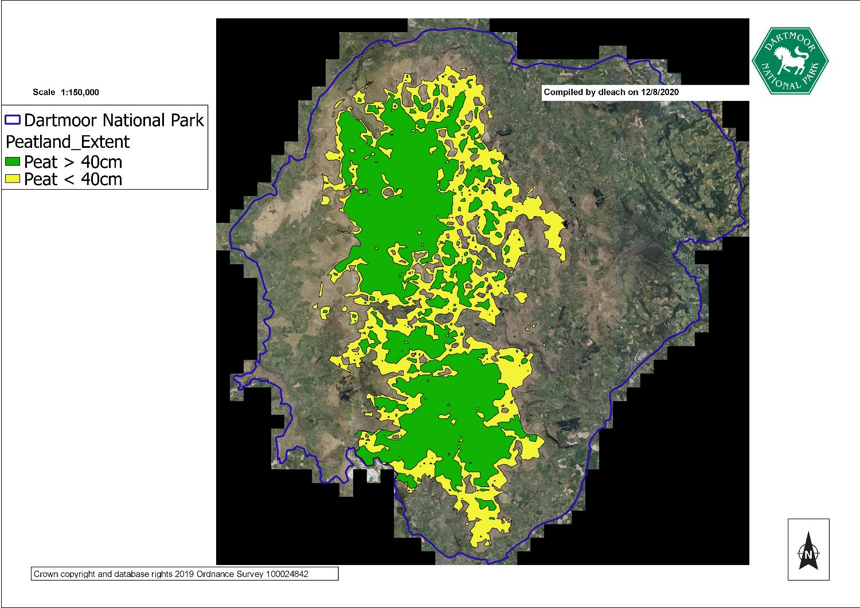
Peat over 40cm deep covers around 158,000 ha of Dartmoor

Slide 4
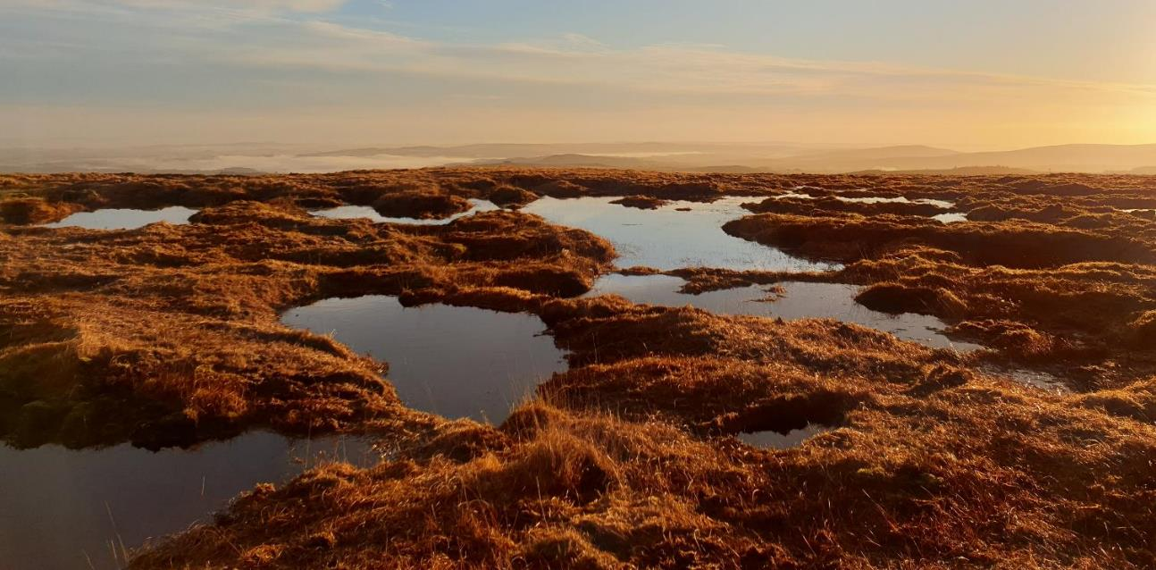
45% of South West Water’s daily water supply for its customers falls as rain on Dartmoor
Okement Taw Teign Bovey
Dart Avon Yealm Erme
Plym Walkham Tavy Lyd

Slide 5
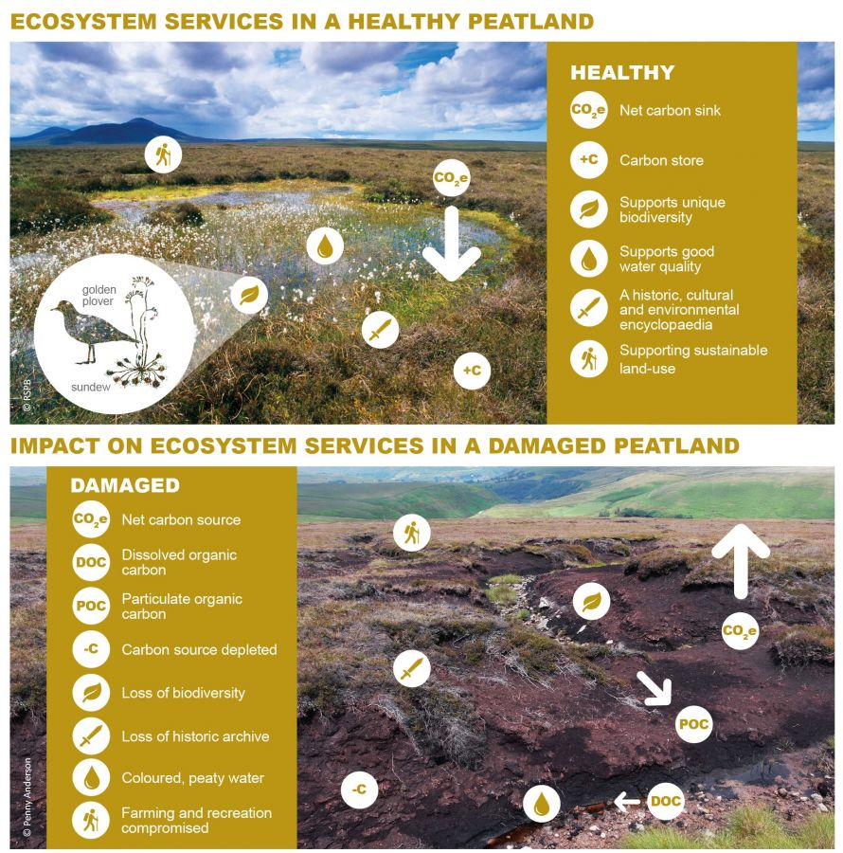

Slide 6
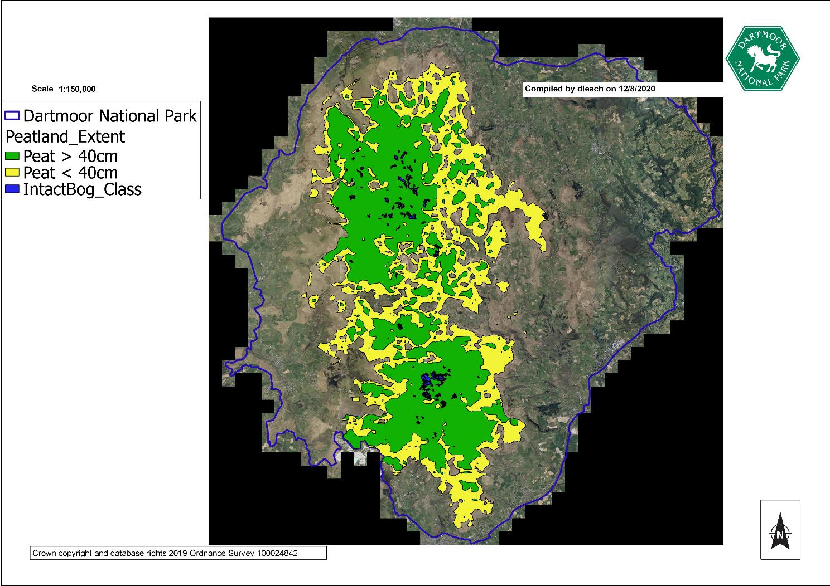

Slide 7
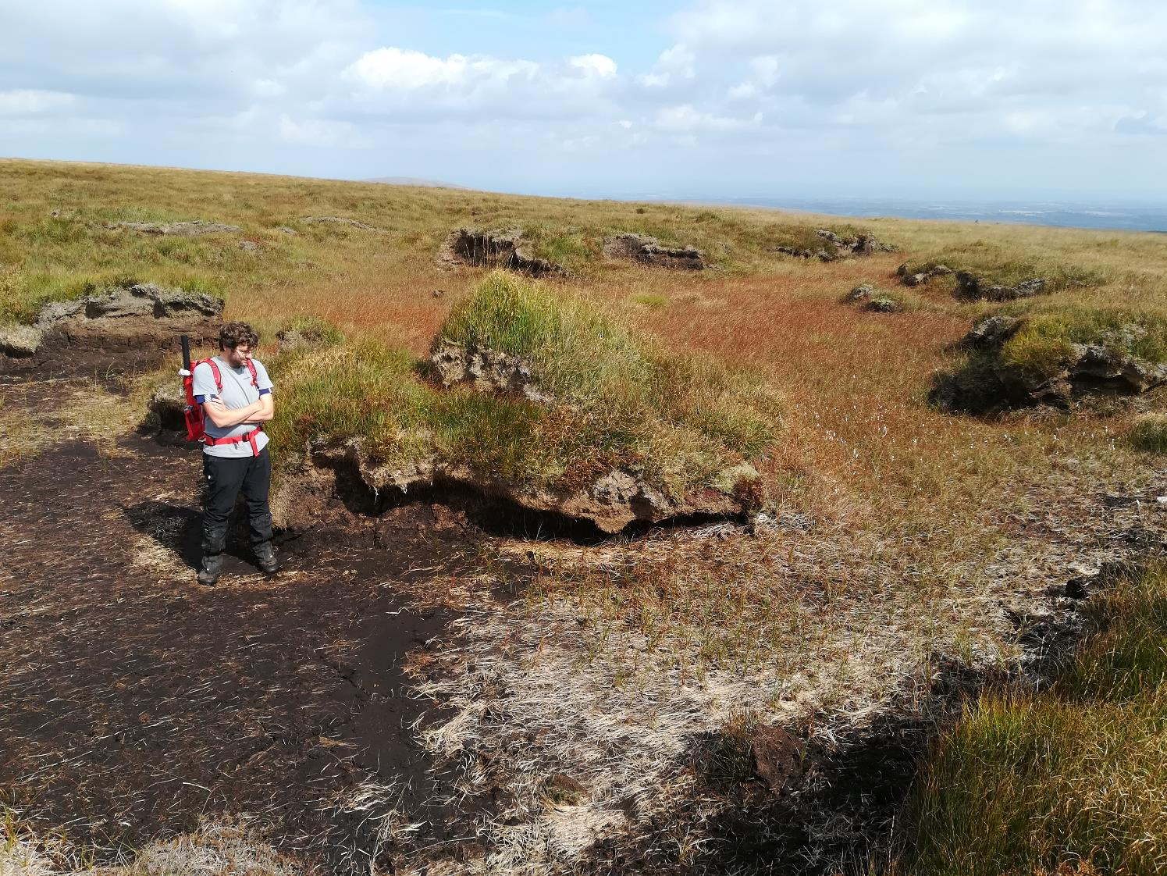

Slide 8
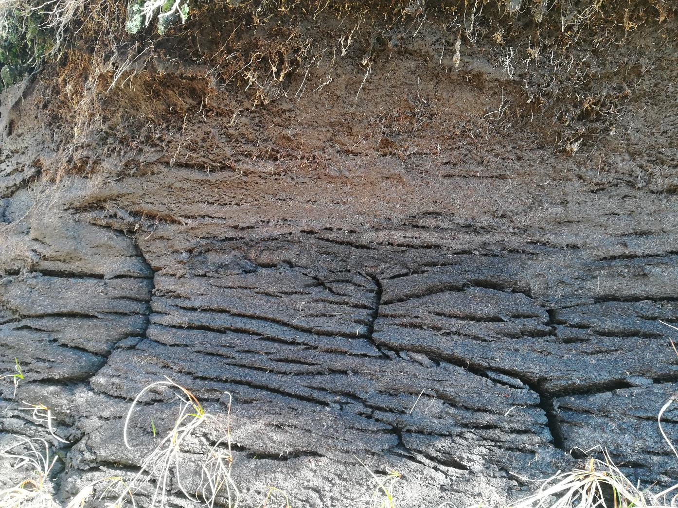
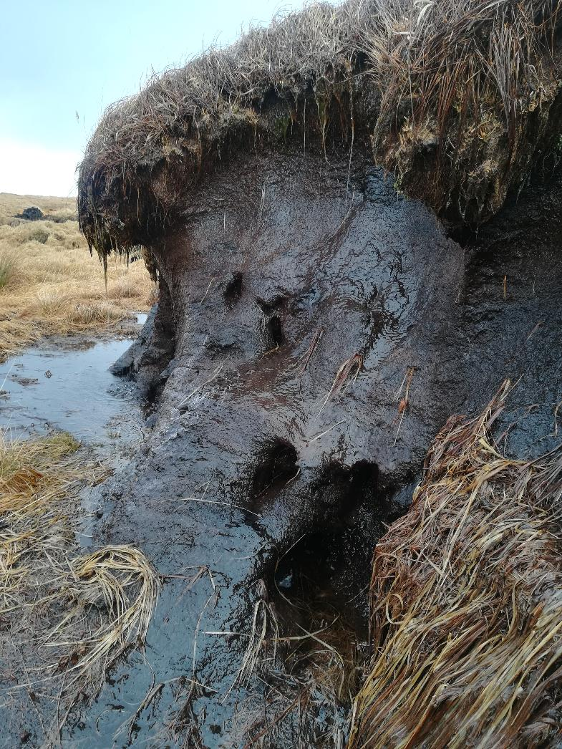

Slide 9
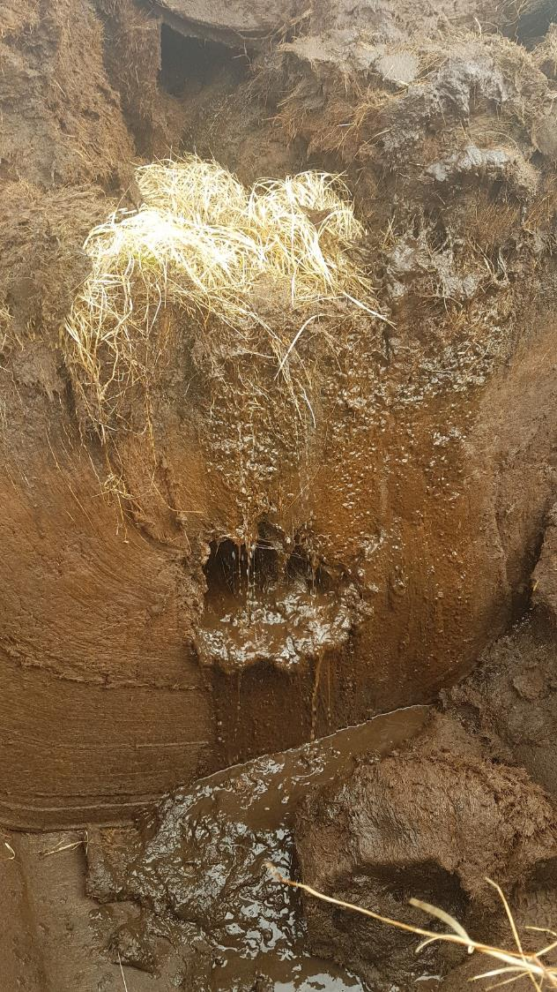
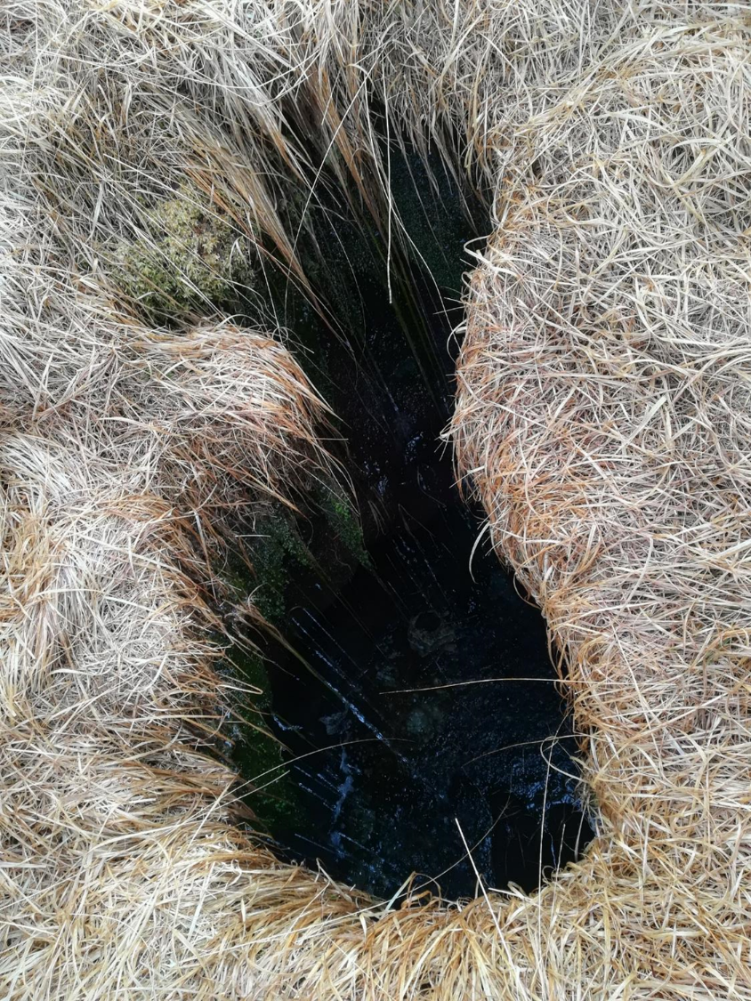

Slide 10
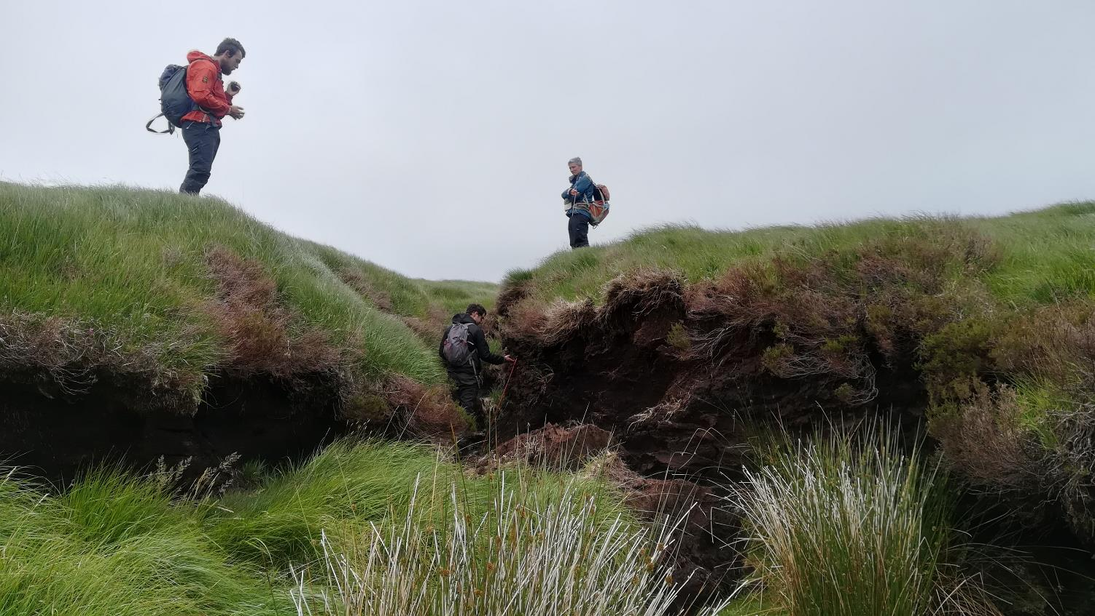

Slide 11
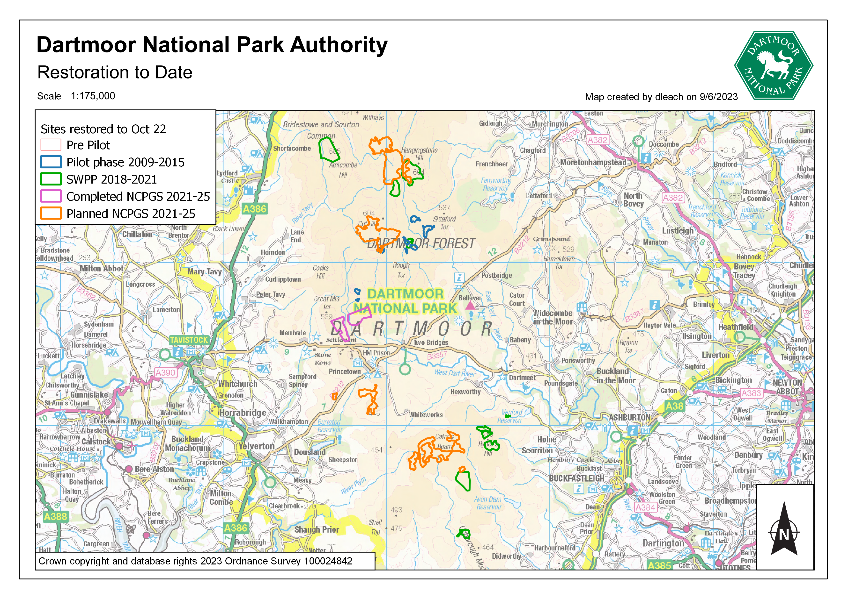
Parts of Hangingstone & Winney’s Down in Upper Teign
Parts of Hangingstone, Black Hill, Cranmere & Flat Tor Pan in East Dart

Slide 12
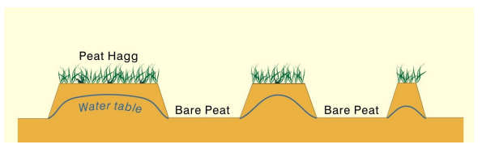
Credit: Allott, T. E. H., Evans, M. G., Lindsay, J. B., Agnew, C., Freer, J. E., Jones, A., & Parnell, M. (2009). Water tables in Peak District blanket peatlands. (Moors for the Future Reports.). Moors for the Future .

Slide 13
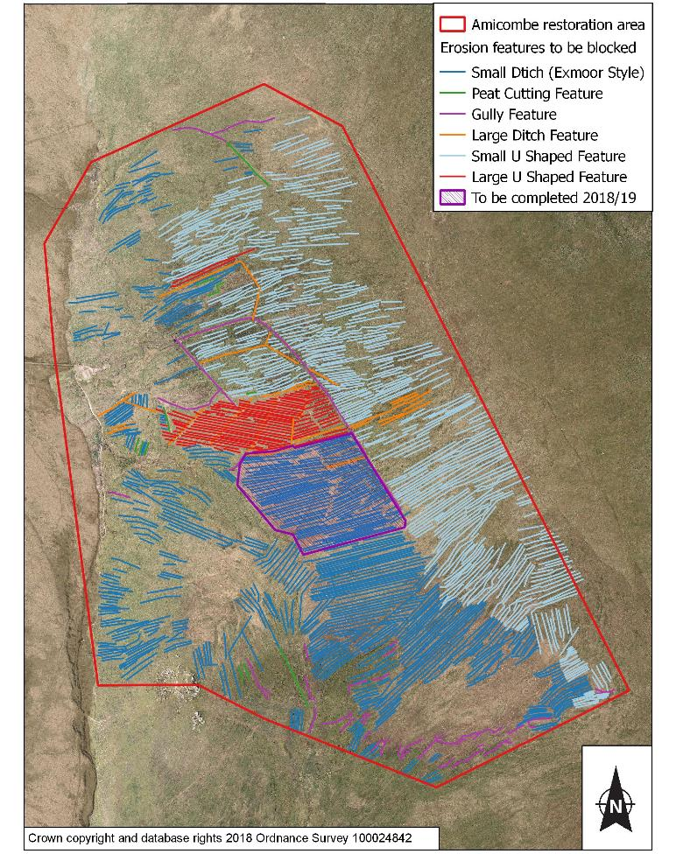
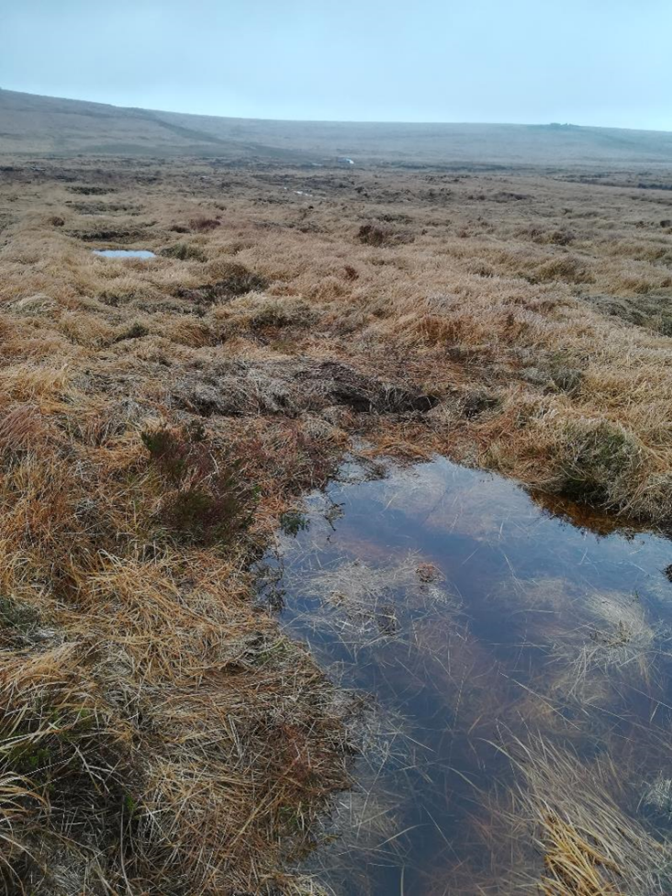

Slide 14
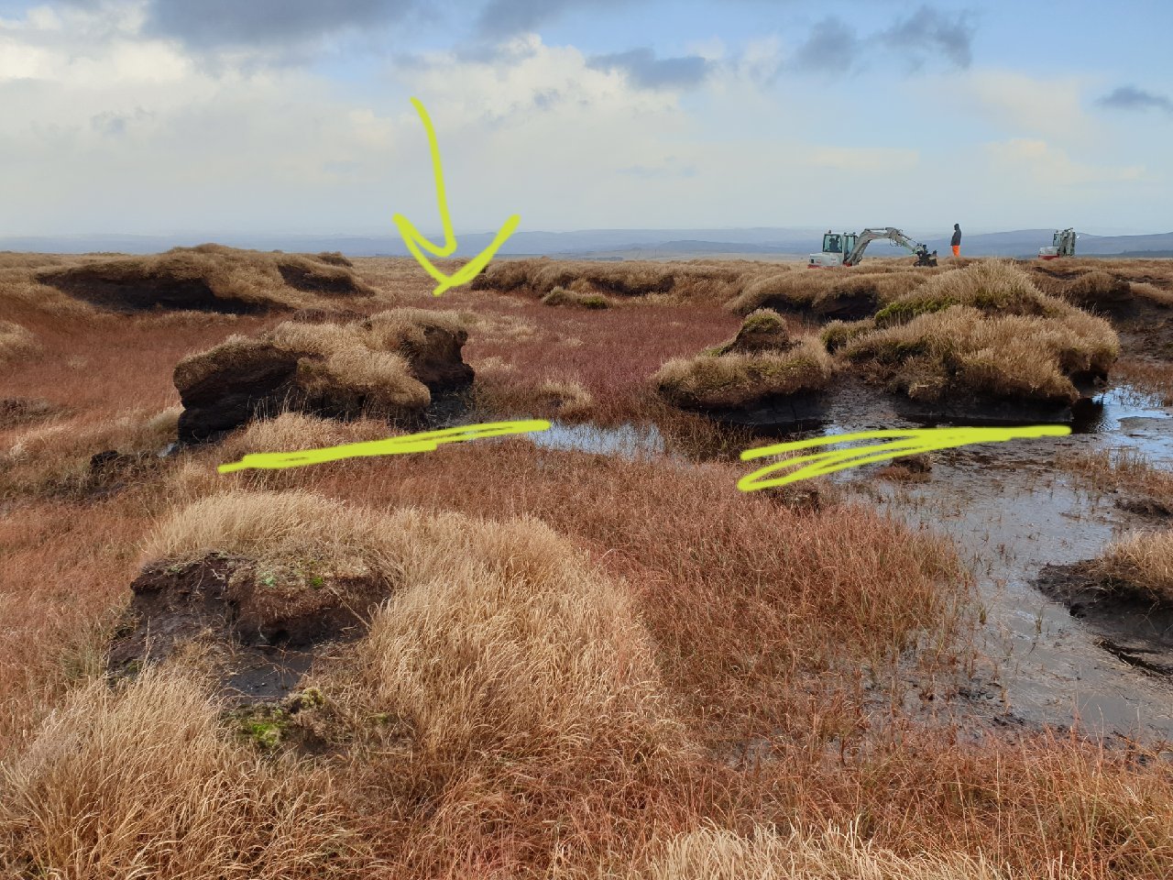

Slide 15
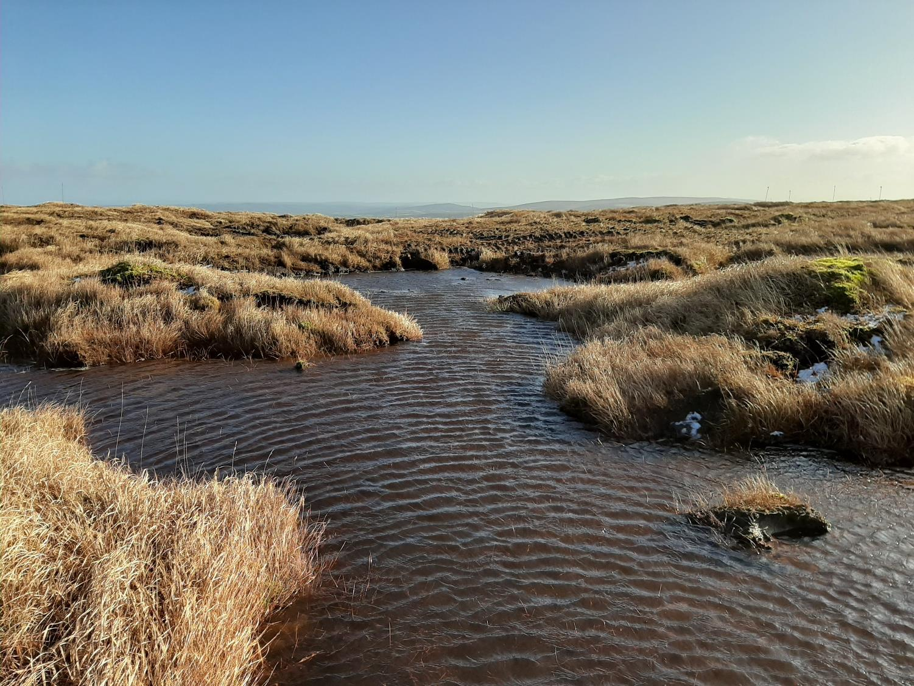

Slide 16
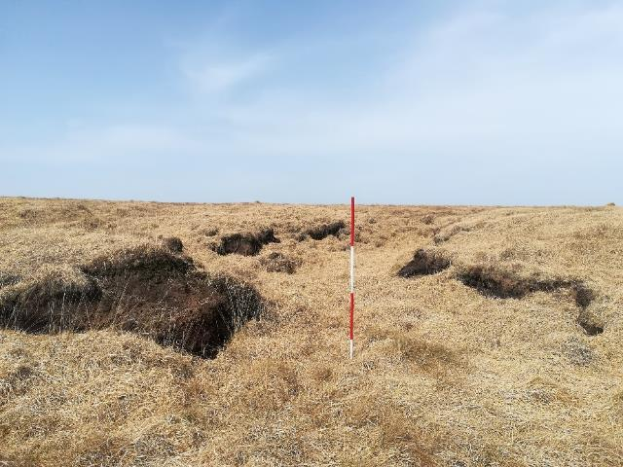

Slide 17
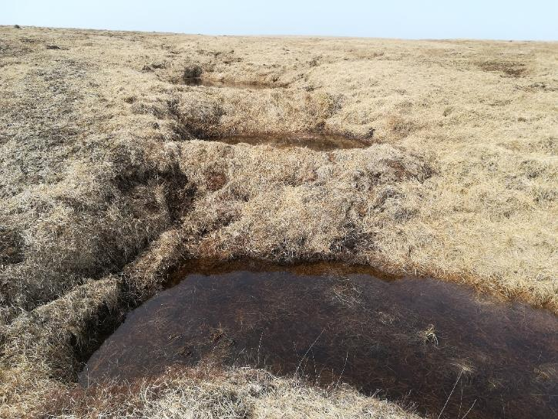

Slide 18
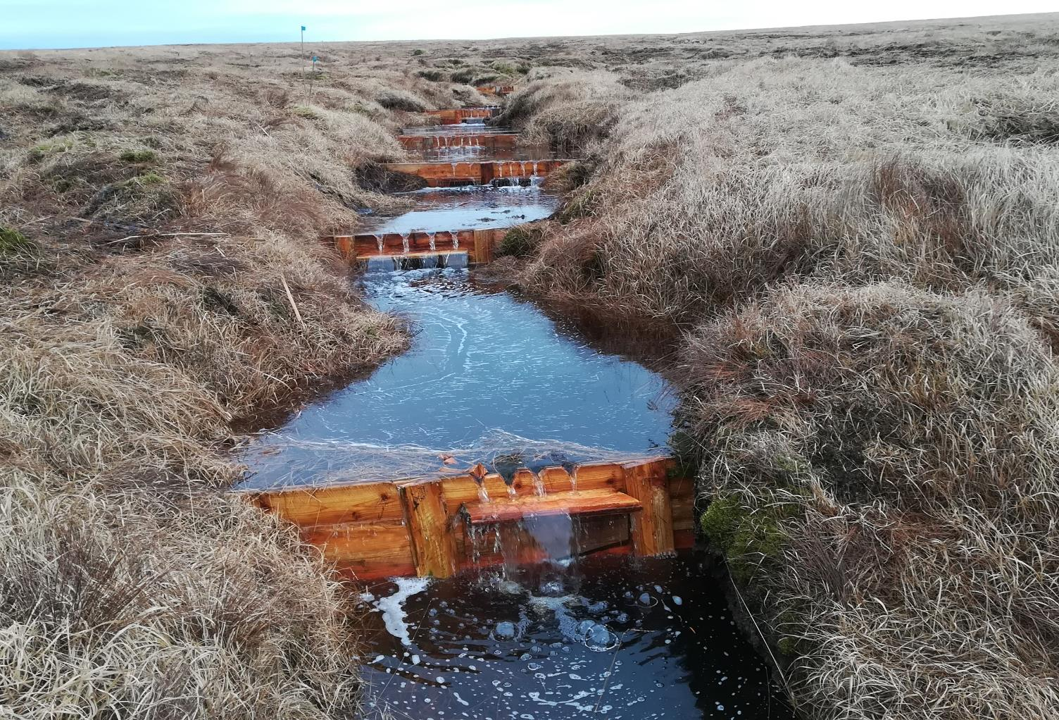
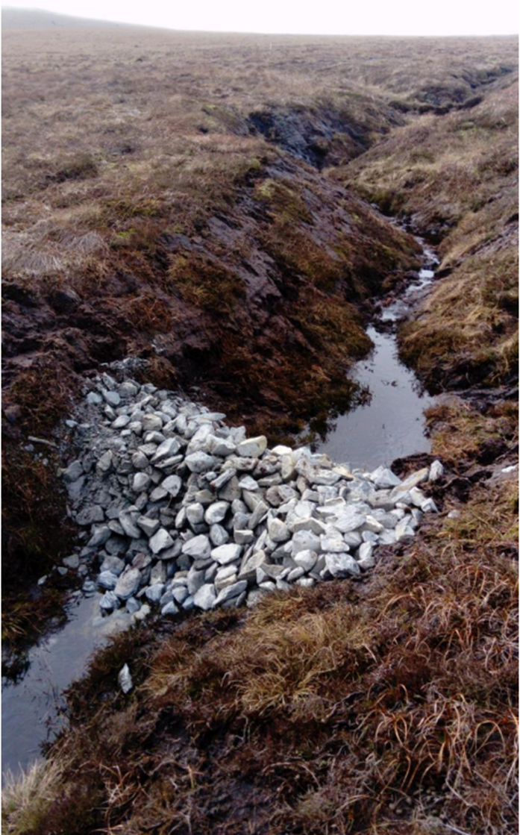


Slide 19
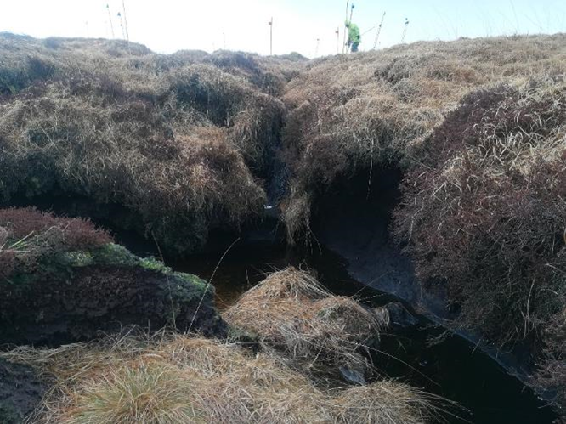

Slide 20
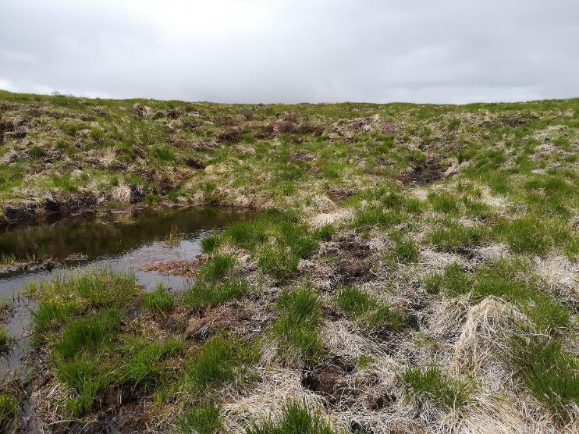

Slide 21
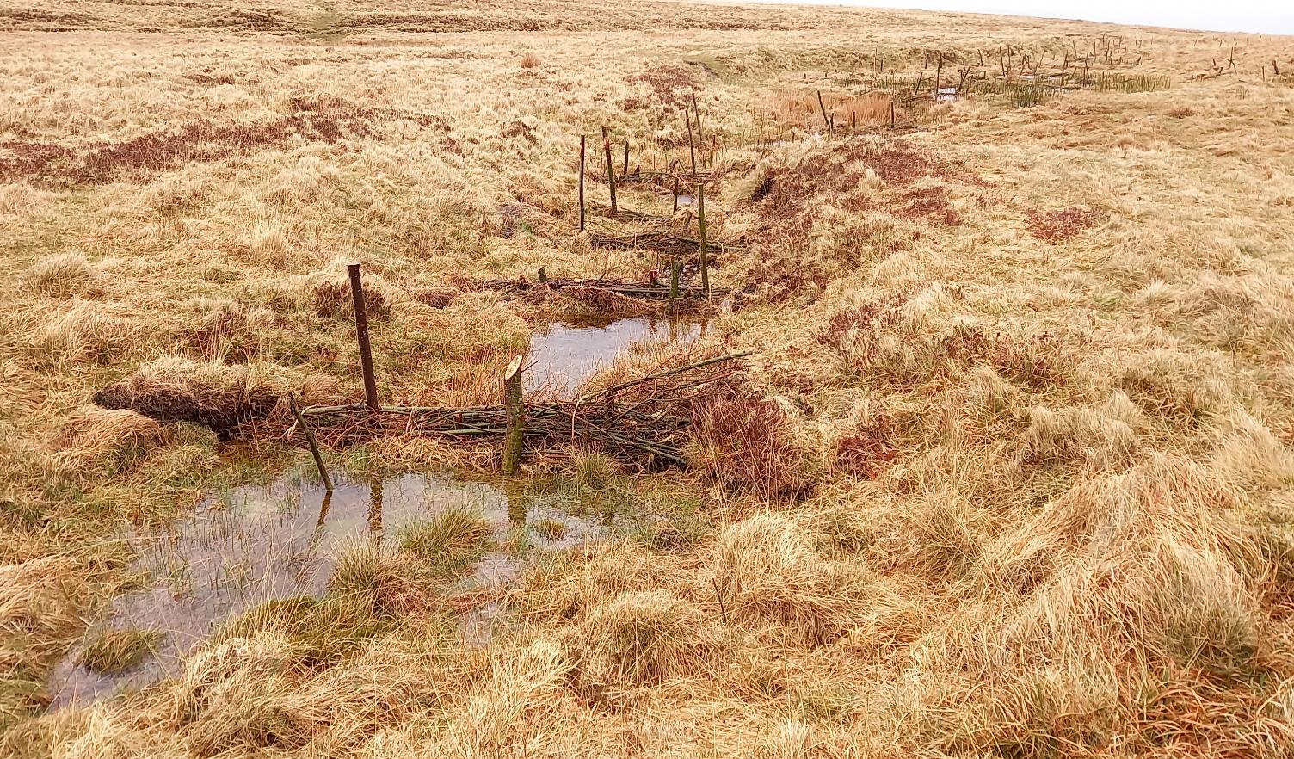

Slide 22
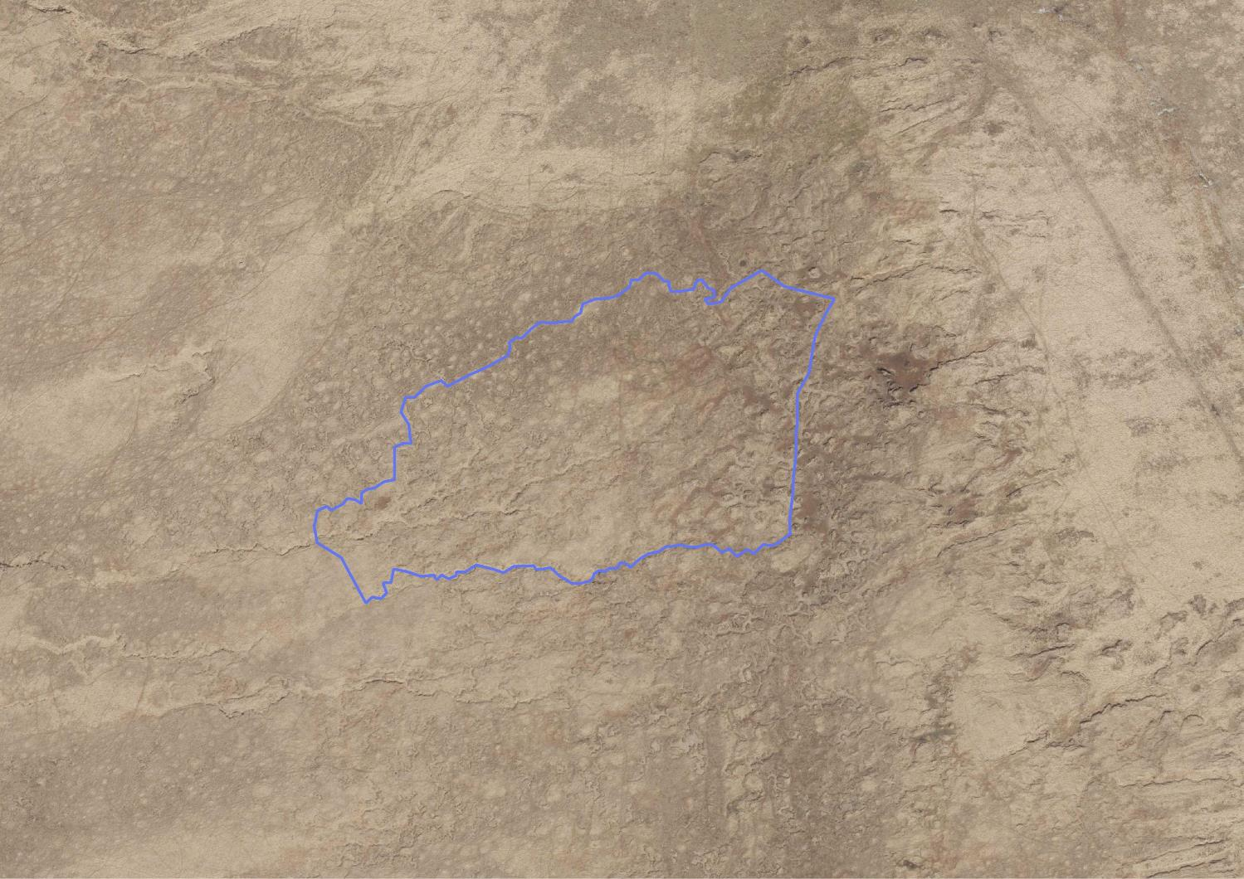

Slide 23
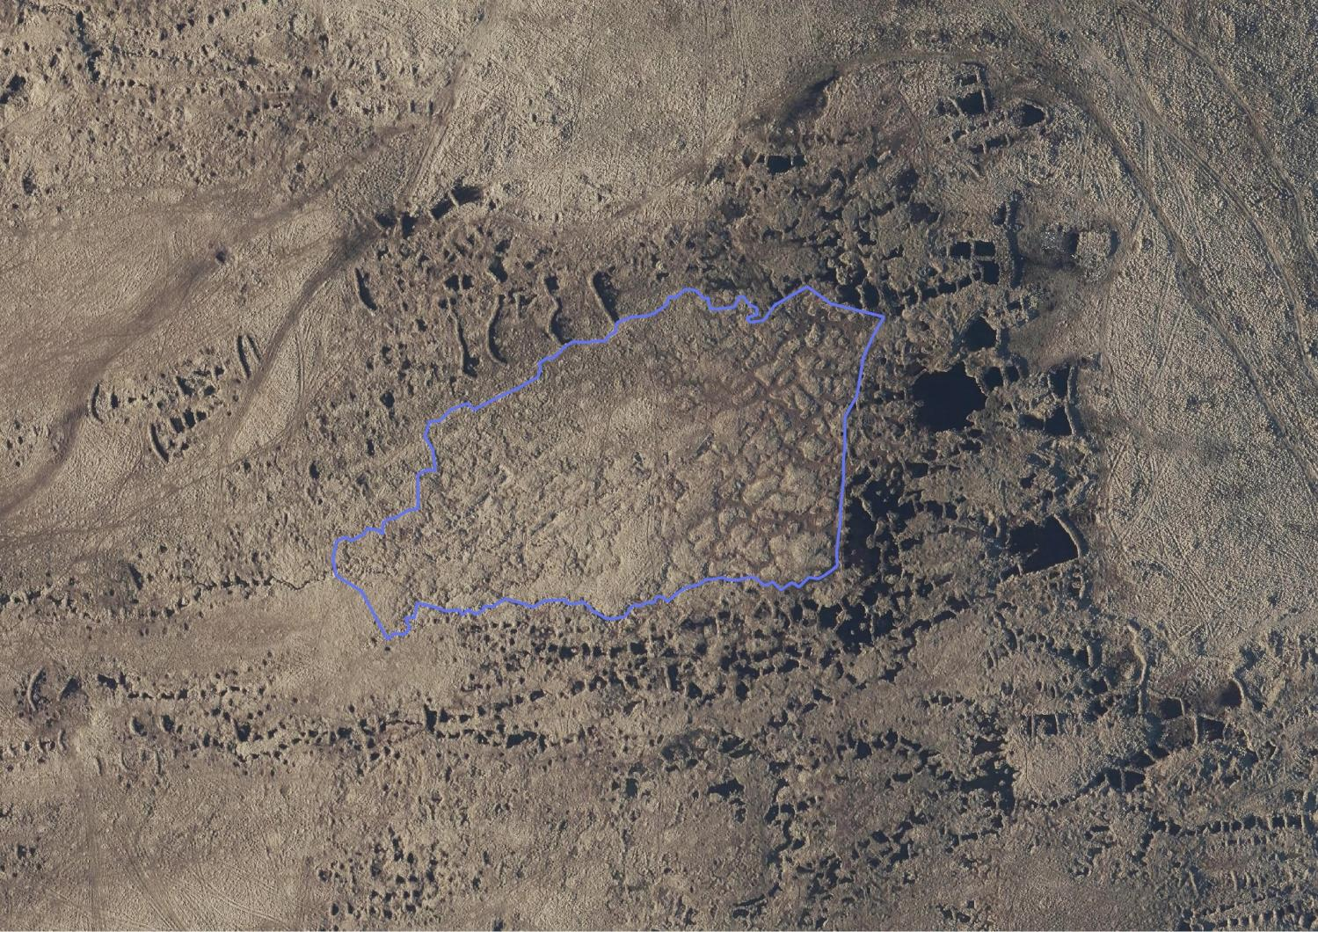

Slide 24
https://issuu.com/universityofexeter/docs/creww_mire_on_the_moors_report_2020/1

Slide 25

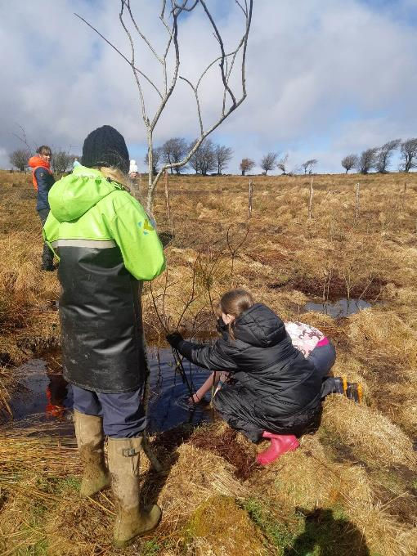
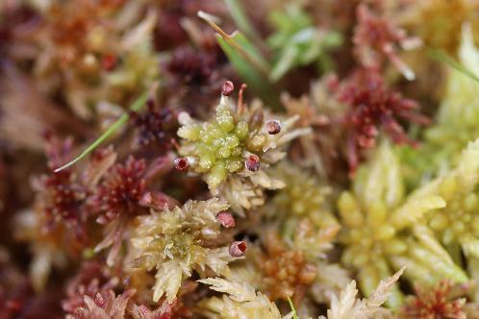

Volunteering with the South West Peatland Partnership
Contact Rachael Land, Education and Engagement Officer
rland@southwestwater.co.uk
22.05.2023

Slide 26
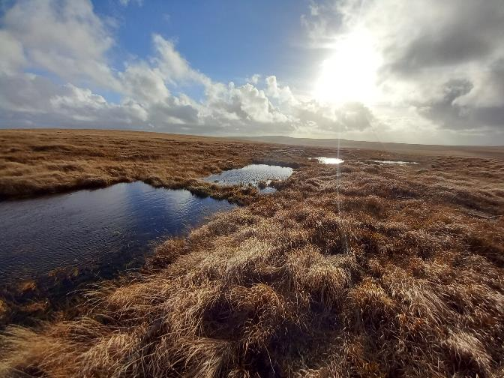
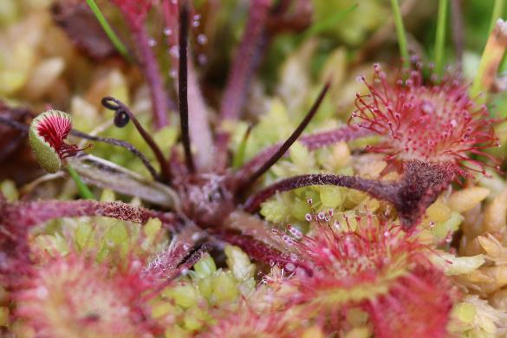
We are not quite ready for volunteers to join our team yet, but look forward to welcoming volunteers with us soon.
Updates will be posted on our website.
Whatever your interests and skills, there is sure to be the perfect role for you.

Slide 27
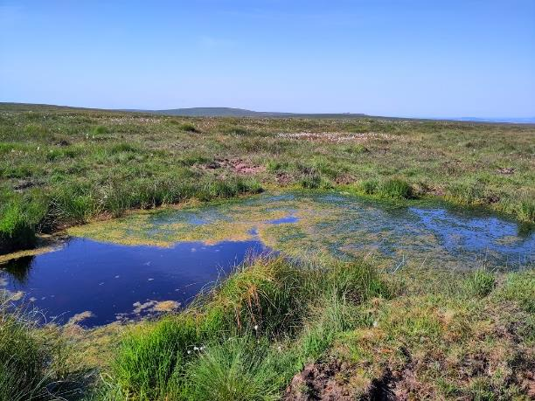
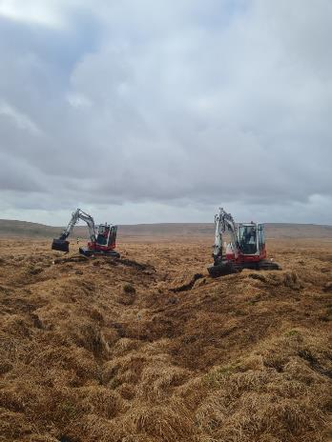
Upcoming volunteer roles will include:
Citizen science
Archeological onsite surveying
Historical research
Ecology monitoring
Fixed point photography
Photographic research
Peatland restoration work party
Some of these roles involve physically active work in the field, others desktop based research, whilst others are somewhere in-between.

Slide 28
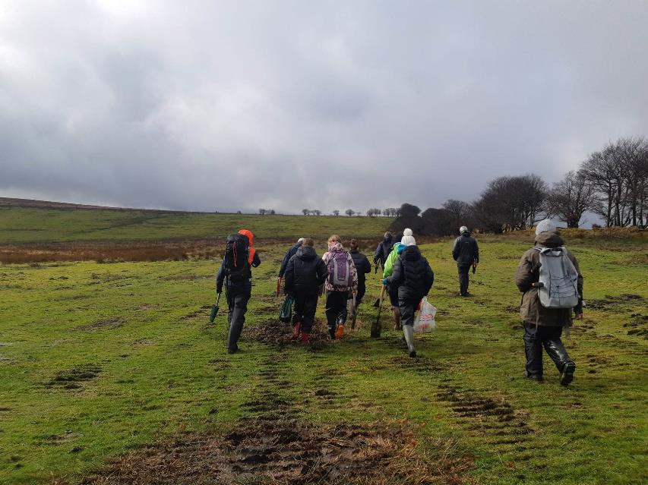
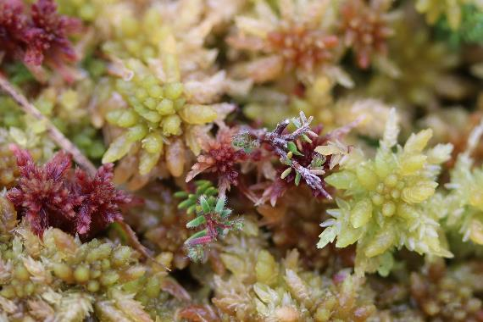

Thank
you
southwestpeatlandpartnership.co.uk

