Slide 1
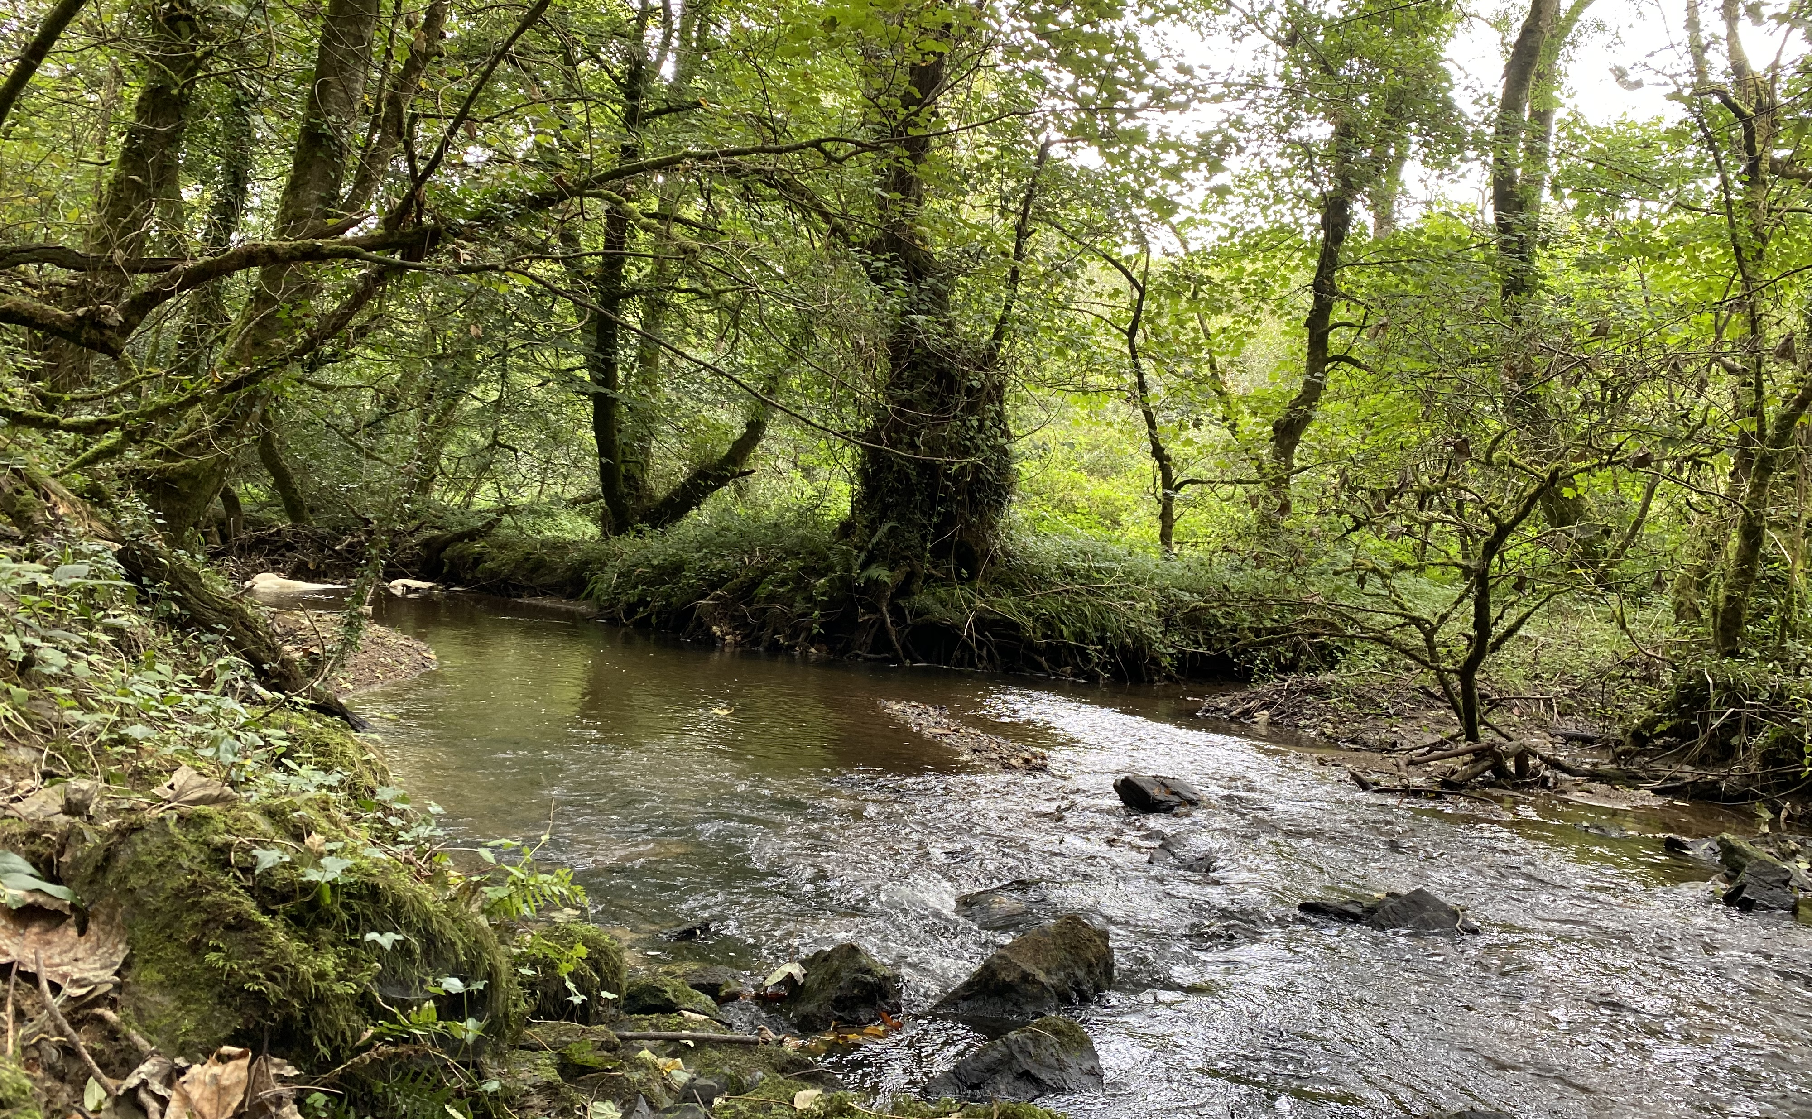

Westcountry CSI
Anna Seal – csi@wrt.org.uk, anna@wrt.org.uk, 07944976638
wrt.org.uk
Photo Credit: Gwynnie

Slide 2
CONTENTS
CONTENTS
wrt.org.uk
wrt.org.uk
  Westcountry Rivers Trust
  Threats to our rivers
  Westcountry CSI – Volunteer monitoring initiative
  How you can get involved
  Our plans for the future
Notes:
Westcountry Dense in rivers due to geology. South West is very surface water driven with a lot of surface run off. A lot of waterbodies, rivers, streams ditches etc. Impact on way pollution enters our rivers as anything sat around on the landscape very quickly finds its way into rivers once it rains.

Slide 3
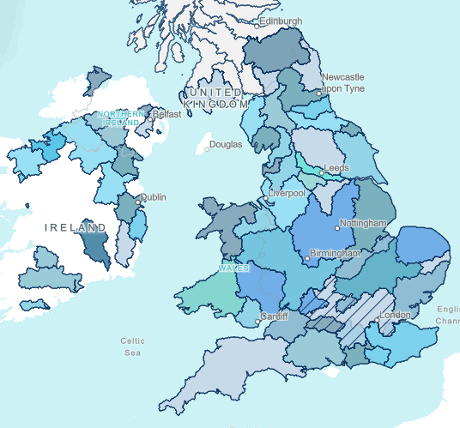

THE WESTCOUNTRY RIVERS TRUST
wrt.org.uk
A new approach – working with organisations to bring about change
Land
Rivers & Fisheries
Evidence & Engagement
Communications
The Rivers Trust Movement
Notes:
Who are we? → founded in 1995 by anglers worried about fish stocks
→ has grown since to over 60 staff members
→ original rivers charity out of which grew the national rivers trust movement
→ cover the South West – Cornwall, Devon, Somerset and Dorset.
→ where enforcement bodies will often live by the “polluter pays” principle, as a charity we tend to follow the “provider is paid” approach because:
→ we ask farmers to not only provide us with food (for which they’re paid) but deliver:
clean water
protect biodiversity
contribute to flood defense
mange landscape character
accommodate recreation and access

Slide 4
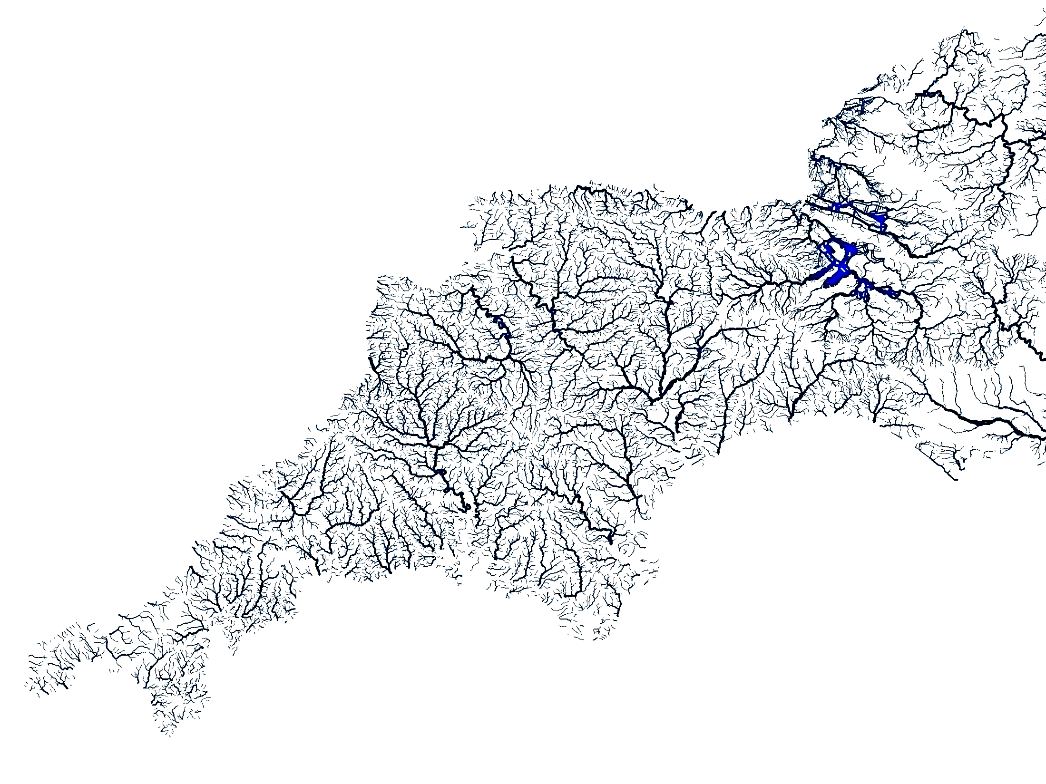




IMPORTANCE OF RIVERS
IMPORTANCE OF RIVERS
wrt.org.uk
Recreation and Wellbeing
Habitats
Drinking Water
Resilience
Notes:
clean water
protect biodiversity
contribute to flood defense
manage landscape character
accommodate recreation and access

Slide 5
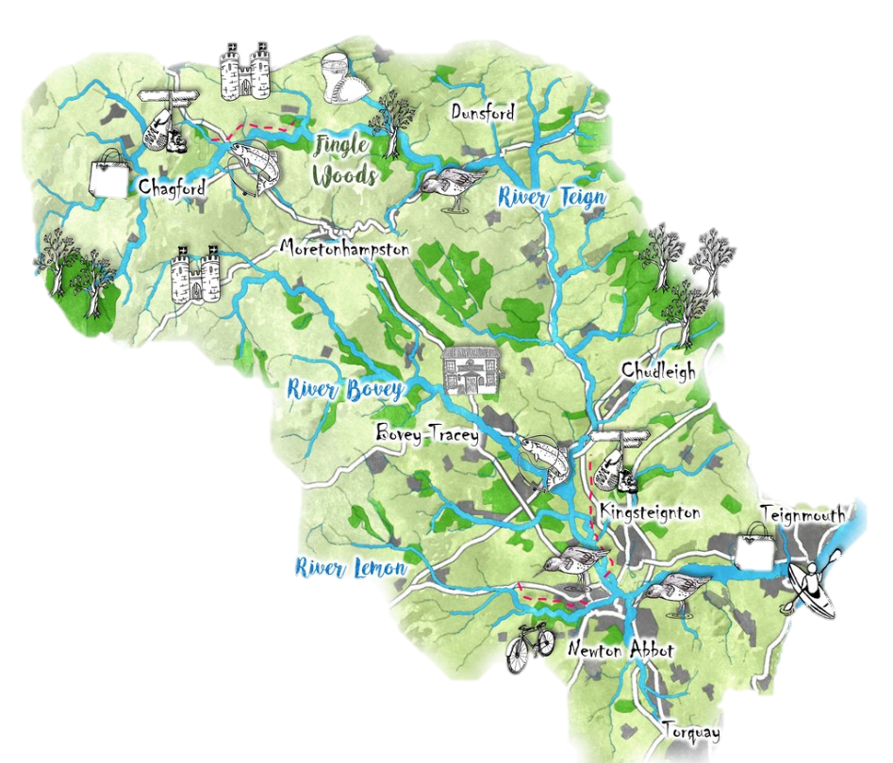
THREATS TO OUR RIVERS
wrt.org.uk
RURAL
URBAN
Soil compaction
Farm run-off
Bank erosion
Changes to the natural river course
Road run-off
Barriers to fish migration
Sewage discharges and overflows
Plastic pollution

Slide 6
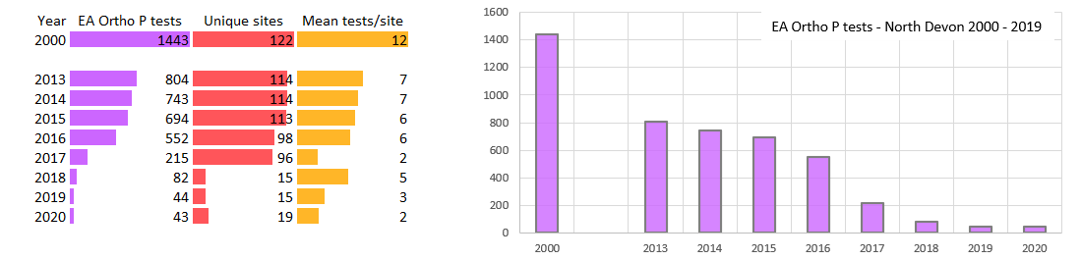
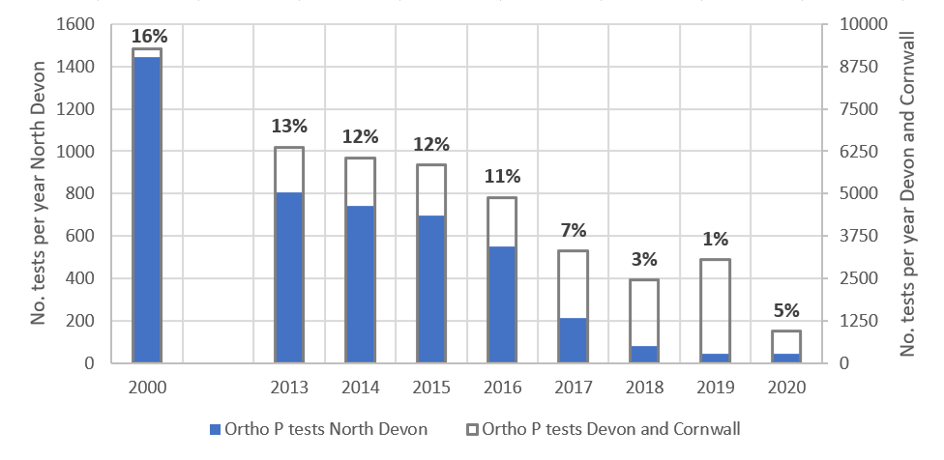
CURRENT MONITORING
wrt.org.uk
Notes:
Ortho P tests as a useful indicator of the amount of Environment Agency water quality monitoring being undertaken in any one year.
By 2013 the number of tests carried out had dropped to around 50% of the year 2000 total, whilst the number of sample points had reduced a little, the main reason for the overall drop in test numbers was a reduction in the sampling frequency – from an average of 12 tests per year to 7 tests per year.

Slide 7
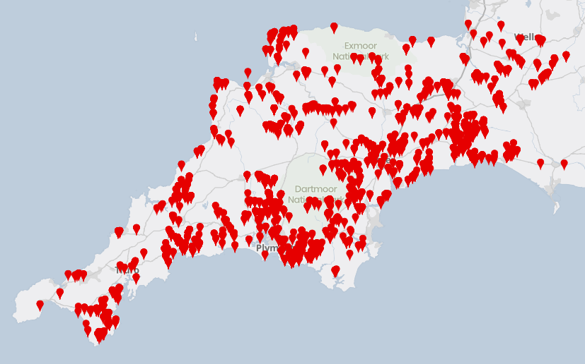

WESTCOUNTRY CSI
wrt.org.uk
AIMS
Educate and engage people with the water environment
Produce low-cost high-coverage data
Spot pollution events which can be dealt with as quickly as possible
Create a network of catchment communities that are invested in their local environment

Slide 8
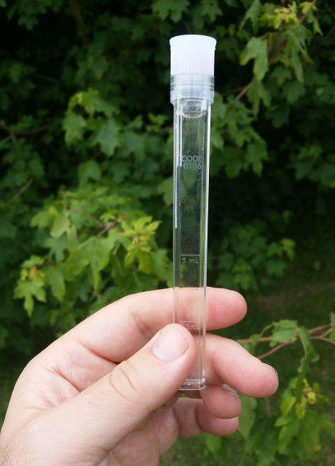
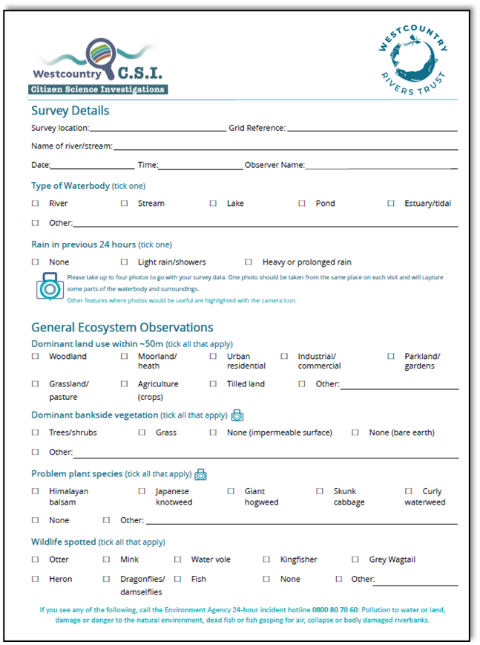
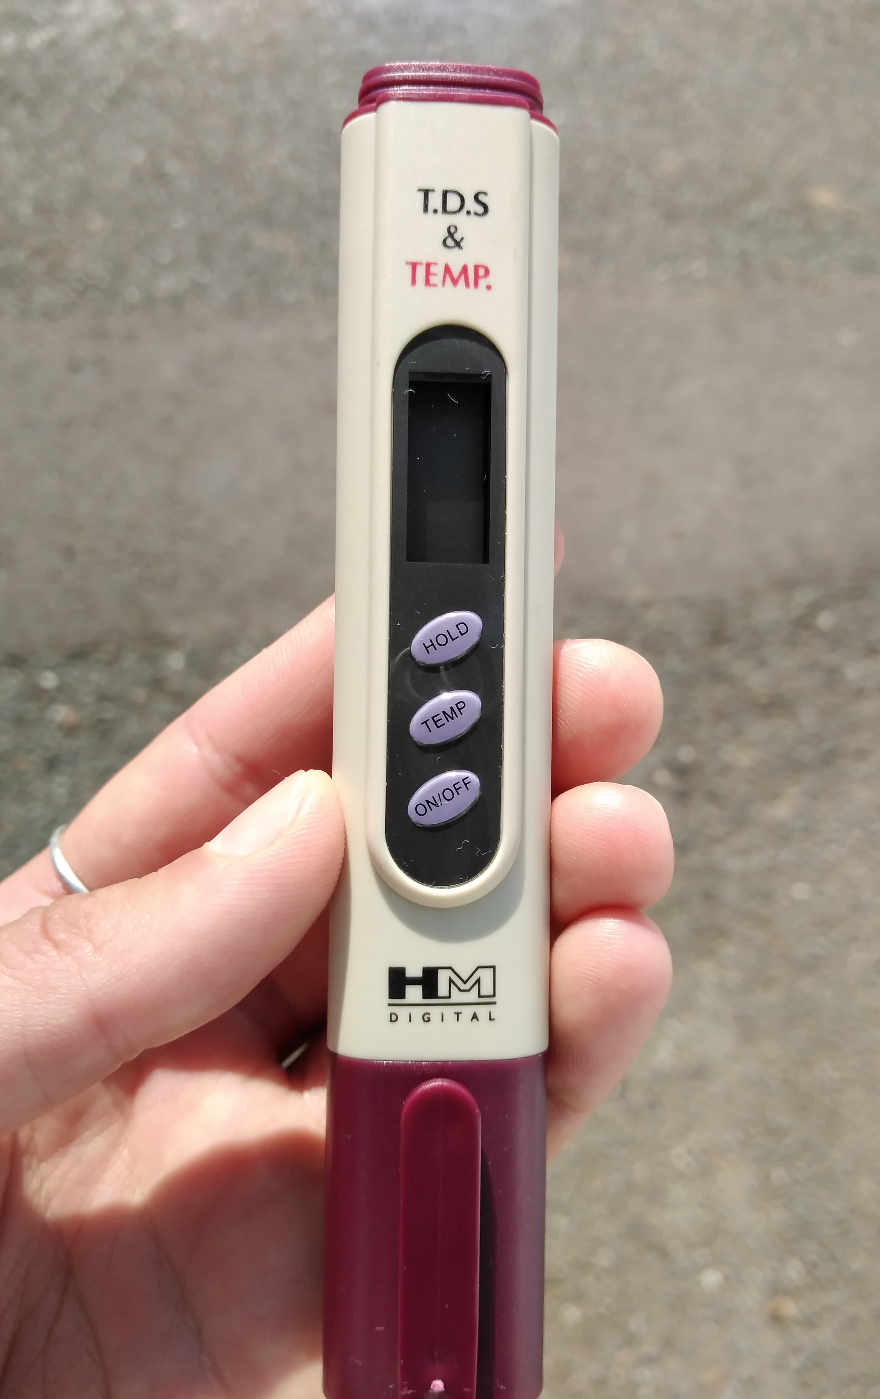
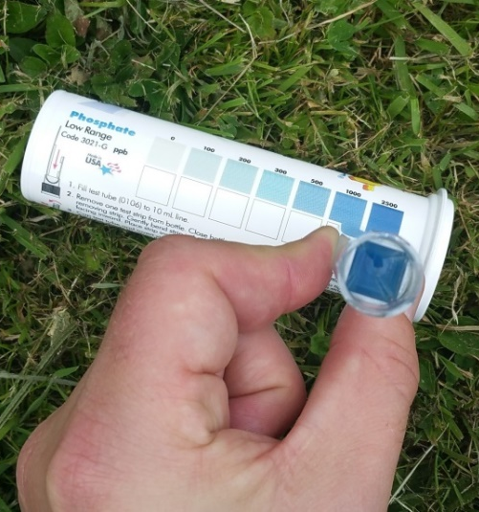
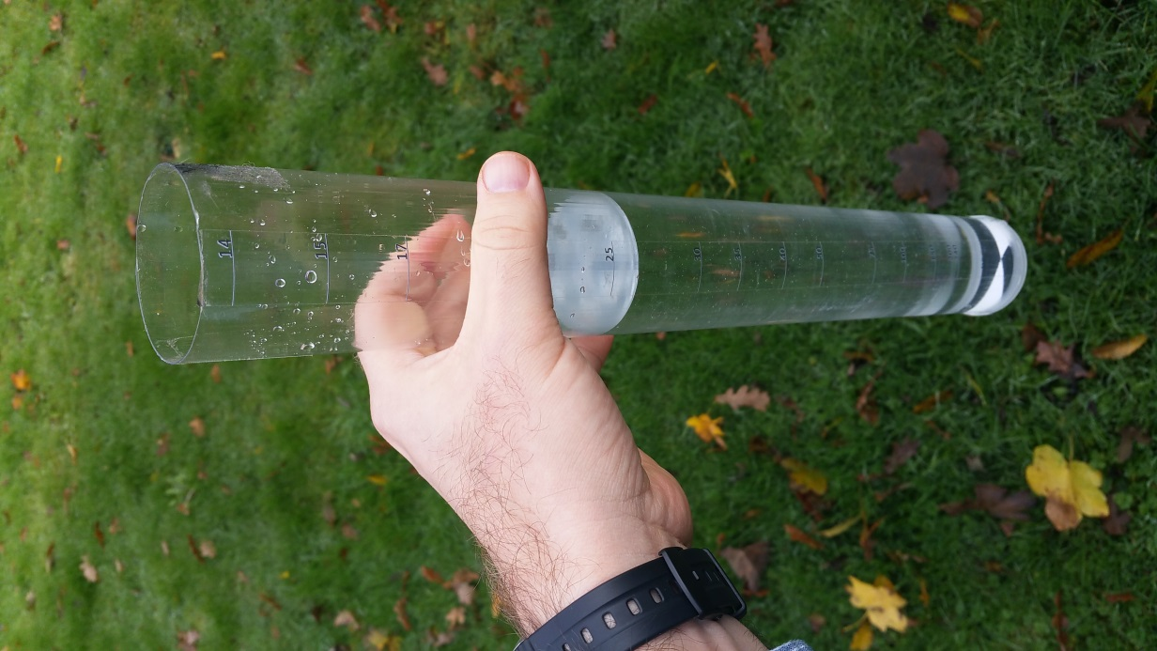
WHAT IS RECORDED
Total Dissolved Solids (TDS) Meter
Phosphate Strip being inverted in sample
Phosphate Colour Chart
wrt.org.uk
Turbidity Tube
Notes:
Based upon a survey form that captures observational information about:
Plants
Wildlife
River condition
Diffuse pollution
Litter/fly-tipping
Flow
Substrate
Photos / notes
How do we go about recording these issues. Observations, very important. Most of the time observations are the basis of reported pollution incidents and part of the reason we have asked for visual surveys to be recorded is to ensure there are eyes and ears looking out for our rivers. The other part of the form is the water quality measurements which you take using the kit shown.
TDS - Total Dissolved Solids (TDS) is directly related to the conductivity of the water. The more minerals, salts and metals that are dissolved in the water the more conductive it gets.
Low levels of dissolved solids in waters such as those on Dartmoor near to the source of the river, are a result of very low levels of input from the surrounding landscape. As the river runs down to the sea it collects material from many different inputs, some natural and some man-made such as farms, sewage plants, factories and residential areas. This typically increases the amount of solids dissolved in the water leading to a higher reading. Harmful pollution from things like sewage, slurry and factory discharge will usually elevate your TDS reading. However, some pollutants such as oil can lower conductivity, therefore it should be used as a general indicator of water quality - not a specific measure of toxicity. Geology will influence the normal level of conductivity in a watercourse (e.g. Areas dominated by granite generally give a lower conductivity than those with limestone ). Regular monitoring will allow the detection of changes in conductivity which can indicate pollution.
Temperature is a vital parameter within the river ecosystem. It controls many of the aquatic species life cycles. Temperature fluctuates with the seasons; however, you do get variation within that, particularly in small rivers and streams. Another important reason to measure temperature is to track the impact of our warming climate on our waterbodies.
Turbidity tube is a measure of the optical clarity of the water. The more suspended particles in the water the lower the clarity and the higher the turbidity.
You will often find your waterbody gets more turbid after heavy rainfall due to soil running off the fields and sediment being mixed into the water column. This loss of topsoil is both a problem for farmer and river. It can often contain chemicals from the fertiliser and pesticides used on the land. An increase in sediment level on the substrate of the river can cause smothering of habitat by removing light and oxygen. Aquatic wildlife such as the less mobile invertebrates and fish eggs struggle to survive in low oxygen conditions and without light, plants are unable to grow.
It is a good idea to sample your river after different weather conditions to understand how it responds to rainfall or drought.
Phosphate occurs naturally within the river ecosystem, but in very low levels under 0.05 mg/l. Therefore, higher levels may indicate anthropogenic input. Phosphate is found in animal and human waste, cleaning chemicals, industrial runoff and fertiliser so this can be a good indicator of pollution. Having raised levels of phosphate can lead to increases in plant growth within the watercourse. This leads to a depletion of oxygen due to the plant’s aerobic respiration during the night. Without oxygen aquatic species cannot survive and the river ecosystem collapses. (It is important to note that phosphate is taken up by plants. You may get a low reading but high plant growth, indicating eutrophication.)

Slide 9
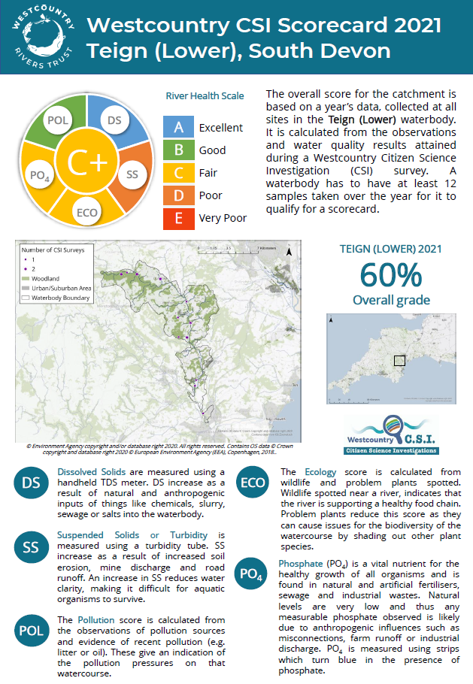
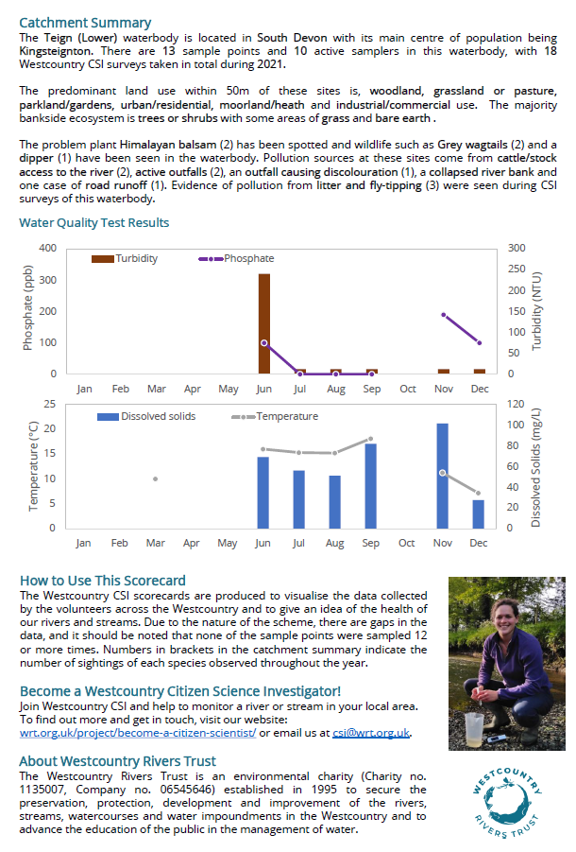
CSI SCORECARDS
wrt.org.uk

Slide 10
GET INVOLVED
wrt.org.uk
442 active volunteers so far this year
14000 surveys and counting…
But there are still lots of gaps to fill
Email us at csi@wrt.org.uk

Slide 11
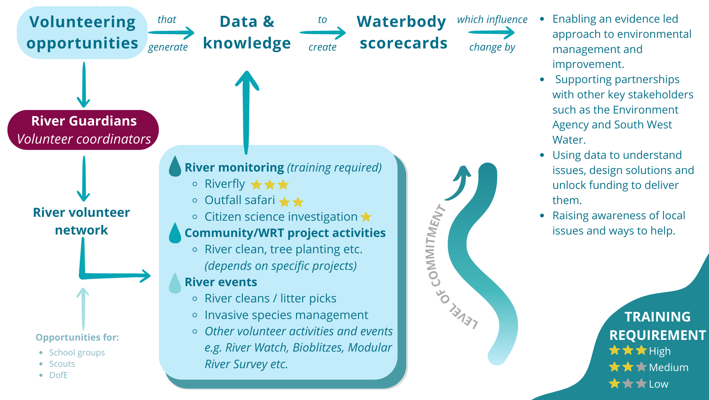
WESTCOUNTRY RIVERS COLLECTIVE
wrt.org.uk
Notes:
Create a tiered volunteer network to establish catchment comminates around each waterbody
Working with the EA to make our data more robust

Slide 12
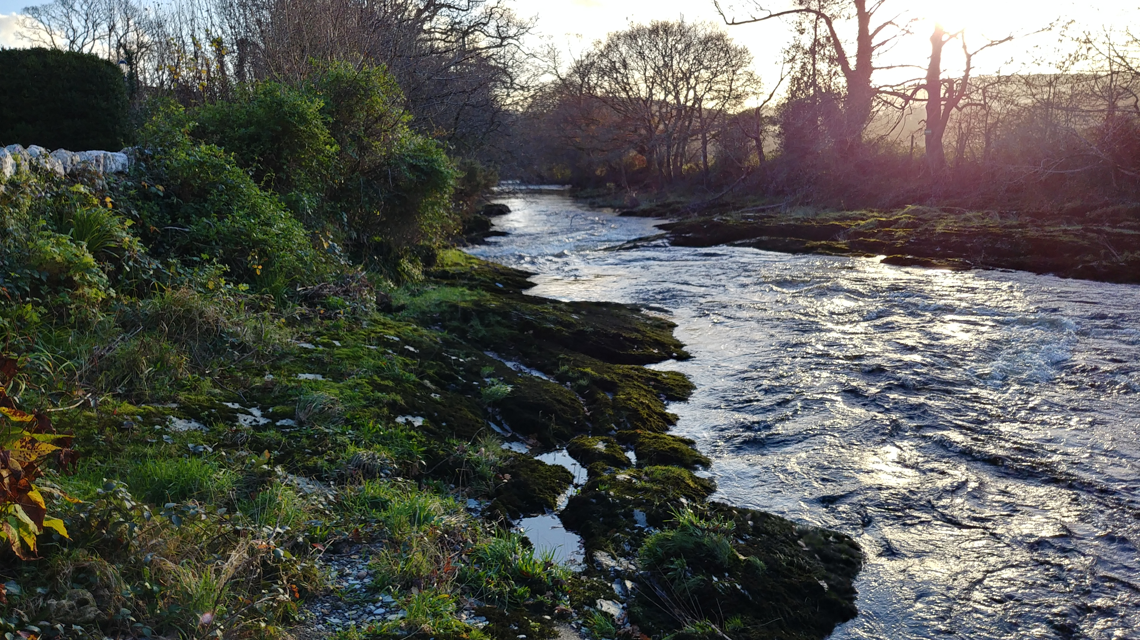
Thank You
Any Questions?
csi@wrt.org.uk
https://wrt.org.uk/westcountry-csi/
wrt.org.uk

